Slide 1
What Do We Mean by “Accessibility Research”?
A Literature Survey of Accessibility Papers in
CHI and ASSETS from 1994-2019
Notes:
Hi everyone, today I’d like to present our research paper “what do we mean by “accessibility research” a literature survey of accessibility papers in CHI and ASSETS from 1994 to 2019.
To begin, let’s discuss why a large-scale analysis of accessibility research is valuable to the community,
An accessible version of theses slides can be found on my website: kmack3.github.io

Slide 2
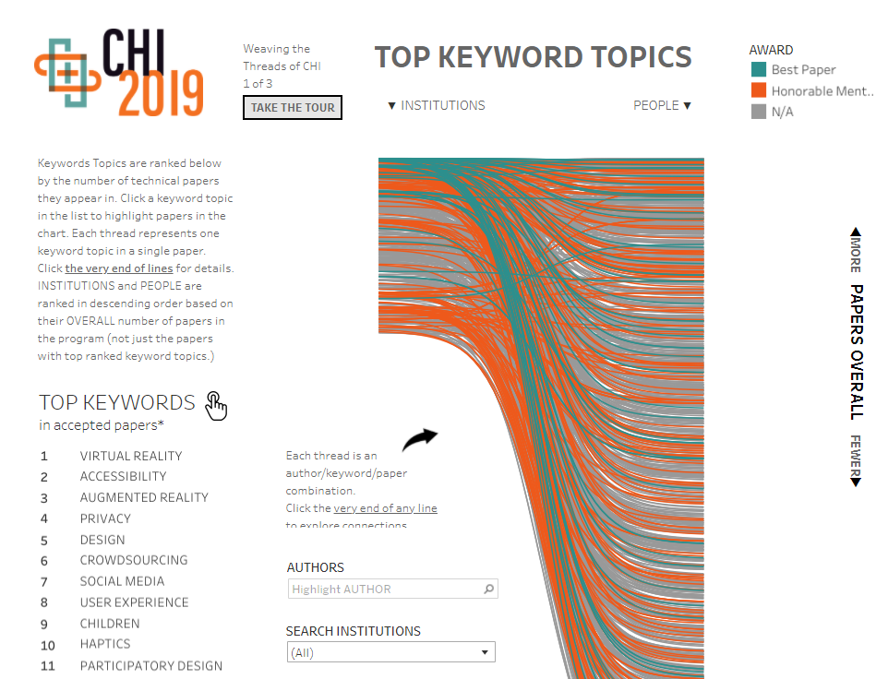
Why is a literature review important?
Accessibility was the second most used keyword in CHI 2019
Notes:
First, accessibility research is growing. It was the second most used keyword in CHI 2019

Slide 3
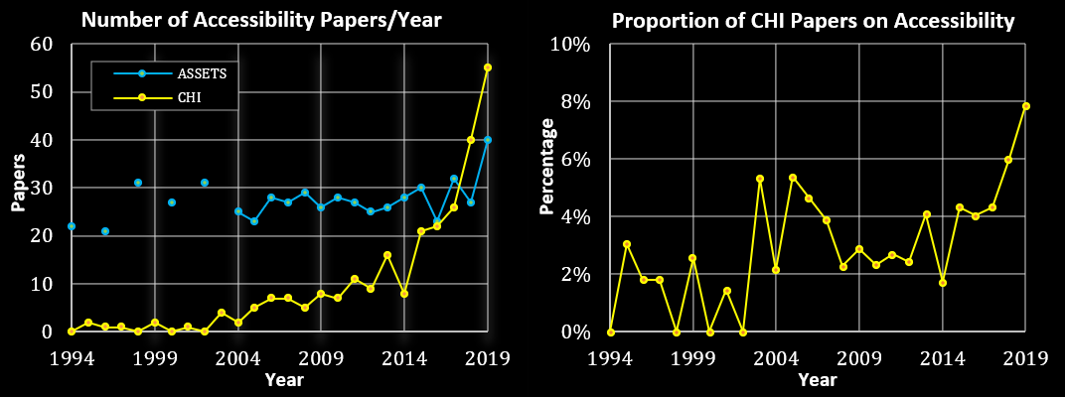
Why is a literature review important?
Notes:
Second, accessibility research, technology, and approaches to working with people with disabilities have changed dramatically since ASSETS was founded in 1994. In this year around 20 accessibility papers were published. More recently, about 95 accessibility papers were published across CHI and ASSETS in 2019. In such a period of growth, it’s important to identify and reflect upon prevailing research norms and trends

Slide 4
Our goal
Perform a large-scale literature review to answer questions such as
What communities are studied?
What research methods are used?
What issues are addressed?
Notes:
Therefore, we chose to Perform a large-scale literature review to answer questions such as
What communities are studied?
What research methods are used?
What issues are addressed?
In accessibility research

Slide 5
Dataset Curation
All ASSETS papers
All CHI papers that use one of:
“disability”, “accessibility”, “impair”, “assistive technology”
In the:
Abstract, title, author keywords
Notes:
We gathered a dataset composed of all ASSETS papers and CHI papers that use one of the key terms “disability”, “accessibility”, “impair”, or “assistive technology in the abstract, title, or author keywords.

Slide 6
Defining our datasets
CHI | ASSETS | Total
215 | 291 | 506
Notes:
In total, we retrieved 215 CHI papers and 291 ASSETS paper for a dataset of 506 papers total.

Slide 7
Data Analysis
Community of focus | Blind or low vision, autism …
Methods | Interview, survey …
Participant count | Number of participants per paper
User groups | People with disabilities, older adults…
Use of proxies | Yes, no
Ability-based comparison | Yes, no
Contribution type | Empirical, artifact…
Issue addressed | Increase independence, support communication
User study location | Laboratory, remote…
Use of participatory design | Yes, no
Notes:
We performed thematic qualitative coding on the dataset which resulted in 10 themes

Slide 8
Data Analysis
Community of focus | Blind or low vision, autism …
Methods | Interview, survey …
Participant count | Number of participants per paper
User groups | People with disabilities, older adults…
Use of proxies | Yes, no
Ability-based comparison | Yes, no
Contribution type | Empirical, artifact…
Issue addressed | Increase independence, support communication
User study location | Laboratory, remote…
Use of participatory design | Yes, no
Notes:
Three of which we will go over today.

Slide 9
Quality assurance
Checked for false positives and negatives in the dataset
Achieved IRR of 0.76
Manually and programmatically verified the qualitative codes
Notes:
To ensure our sample was complete, we manually examined all papers for false positives and sampled a random 200 papers to check for false negatives, of which there were only three. We also established an average IRR of .76 for qualitative codes, and manually and programmatically reviewed the fully coded dataset to ensure high quality data.

Slide 10
Who do we study?
Overwhelmingly focused on people who are blind or low vision
Notes:
Now, moving onto the results, with respect to who we study in the accessibility community– we see that we overwhelmingly focus on people who are blind or low vision; 44% of papers were this group, followed at 14% by people with motor impairments, whereas people with motor impairments are the most represented disability in the world. On the other end of the spectrum, we see that people with autism and IDD occurred much less frequently in 6% and 3% of papers respectively. These latter groups serve as areas of potential growth for future accessibility research.

Slide 11
Who do we study: takeaways
Consider how our research might include those underrepresented
Multiple disabilities
Multiple people with different disabilities
Chronic illness
Mental Health
Intersections of other marginalized identities (e.g., gender, race)
Hofmann, Megan, et al. "Living Disability Theory: Reflections on Access, Research, and Design." The 22nd International ACM SIGACCESS Conference on Computers and Accessibility. 2020.
Notes:
Further, we suggest that we consider how our research might include groups that are underrepresented in our sample, including people with multiple disabilities and the unique needs that arise from the intersection of being both autistic and blind, for instances. Multiple people with different disabilities interacting together, which as Hoffmann et al points out, is more common than we might think. People with chronic illness or mental health concerns, as these are becoming more prominent in our society. And finally, studying the intersection of other marginalized identities such as gender or race and disability.

Slide 12
What methods do we use?
Almost all have user studies (94.3%)
Use of qualitative and quantitative methods
Notes:
Moving onto what methods we use– 94% of papers included user studies and we saw a mix of quantitative and qualitative methods used, and often papers included a mixture of methods. The top methods were interviews and usability testing at about 42%. On the other hand, focus groups and case studies were used infrequently, in about 6% and 4% of papers respectively.

Slide 13
Participants engaged
Median number of participants with disabilities or older adults recruited per paper was 13
Median sample sizes in HCI are 15-16
However, specific subpopulations diverged from this median
Group | M
DHH | 28
General DA | 19
Cognitive | 16
Older Adult | 15
BLV | 13
IDD | 11.5
Motor/Physical | 10
Autism | 9
Lisa Koeman. 2020. HCI/UX Research: What Methods Do We Use? Retrieved August 8, 2020 from https://lisakoeman.nl/blog/hci-ux-research-what-methods-do-we-use/
Notes:
We also looked at how many participants were engaged in each paper. The median number of people with disabilities or older adults per paper was 13, which though smaller, is close to the overall HCI median of 15-16 participants per paper, as Koeman reports. However, specific populations had considerably different medians such as deaf of hard of hearing people at 28 participants per paper and people with autism at 9 participants per paper.

Slide 14
What methods do we use: takeaways
We saw smaller sample sizes than in broader HCI
Not much use of methods tailored to small sample sizes
Consider if broader HCI norms are appropriate for accessibility research
Notes:
To reflect on these results, we saw use of relatively small sample sizes for several groups. But, surprisingly we saw little use of methods tailored for smaller sample sizes like case studies or single-subject experiments. Therefore, we ask the community and reviewers to consider whether broader human-computer interaction norms are appropriate for an accessibility paper given the community of focus, method used, and contribution made.

Slide 15
Contributions
Accessibility research is growing
The community needs to take time to reflect on norms and trends
Notes:
In sum, accessibility research is growing! Now more than ever is an important time to reflect on the norms and trends in our research community to ensure that they are effective both in creating high quality research and reaffirming the rights and comfort of the people our research aims to serve.
We hope that this work spurs these reflections and discussions within the community and serves as a guide to help onboard newcomers to the community

Slide 16
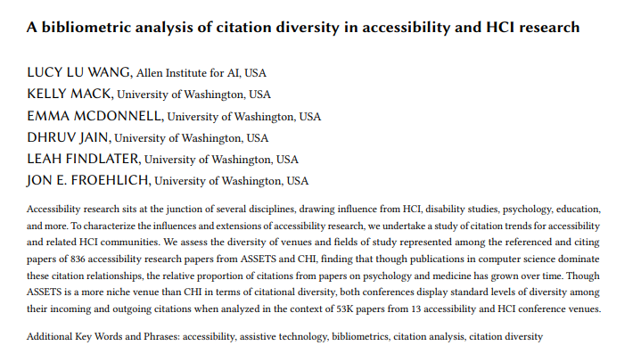
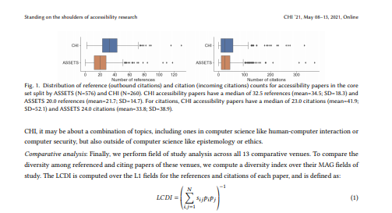
Wang et al. Late Breaking Work
Wang, Lucy Lu et al. “A bibliometric analysis of citation diversity in accessibility and HCI research." In Extended Abstracts of the 2021 CHI Conference on Human Factors in Computing Systems (CHI EA ‘21).
Notes:
If you want to learn more, please visit us for our late breaking work presentation by Dr. Lucy Lu Wang: “a bibliometric analysis of citation diversity in accessibility and HCI research”

Slide 17
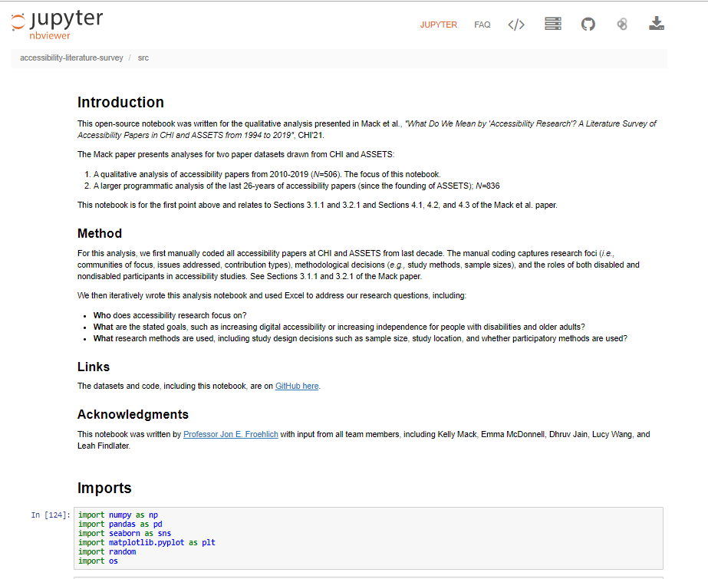
Engage with our data
https://github.com/makeabilitylab/
accessibility-literature-survey
Notes:
Our dataset, qualitative codes, and data analysis scripts are open source on github

Slide 18



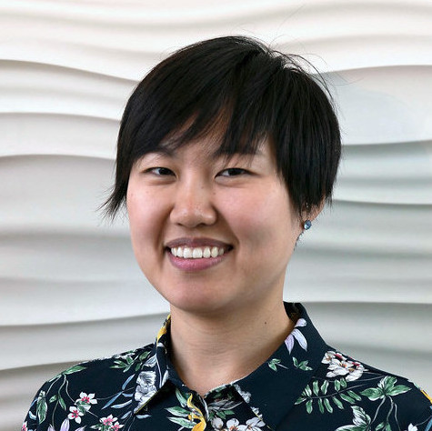

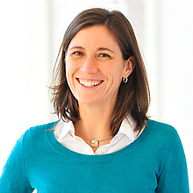



Acknowledgements
Kelly Mack
kmack3@uw.edu
Emma McDonnell
ejm249@uw.edu
Dhruv Jain
djain@uw.edu
Lucy Lu Wang
lucyw@allenai.org
Jon E. Froehlich
jonf@uw.edu
Leah Findlater
leahkf@uw.edu
Notes:
Finally, I would like to thank my fabulous collaborators Emma McDonnell, Dhruv Jain, Dr. Lucy Lu Wang, Dr. Jon Froehlich, and Dr. Leah Findlater, as well as our funding agencies. Thank you.

